Slide 1
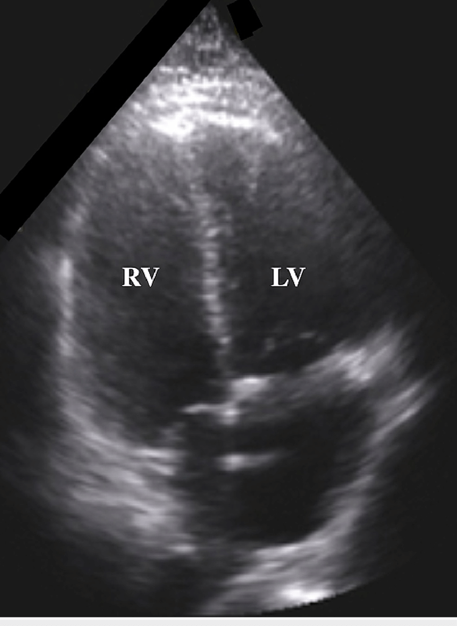
ED Case of the week 4
Learning points
Assessment of management of PE
Thrombolysis indications and guidelines
The Case:
65F presented with SOB and left sided chest pain for 2 days
Elective right hip replacement 2 weeks previously. Taking apixaban but ?missed 1 or 2 doses.
Pre alerted to resus as sats 92% on 15L O2. On YAS arrival GCS was 7 but improved to 14 once hypoxia corrected and was 15 in ED.
On arrival to ED:
A - Maintaining
B - Chest clear, sats 94% on 15L O2 with T1RF on ABG. pO2 16 on 15L O2.
C - HR 120 SR, BP 112/80, Cool peripheries. Briefly dropped BP to 92/60 but responded to a 500ml fluid bolus
D - GCS 15 now, no neurological deficits
E - T35.8, Right leg slightly swollen but 2 weeks post op. Nil else to find on examination
Initial thoughts:
High likelihood of PE
Significant hypoxia, but haemodynamically ‘stable’
Any other adjuncts we could use?
POCUS I hear you cry!
RV dilation explained!
Risk stratification - Diagnosis
Wells score first - if high, d dimer is irrelevant
If low Wells score, and clinical suspicion is not high, can we exclude it with the PERC score?
If low Wells score then, and only then, do a d dimer
If age >50 use age adjusted (age x 10)
See EMBeds PE page for summary of diagnostic pathways
Pregnant patients are another kettle of fish!
If unsure, involve seniors in decision making around investigation of PEs as it is notoriously difficult!

Slide 2
ED Case of the week 4
Pulmonary embolism - Treatment if stable
For stable patients with confirmed or suspected PE, LMWH is the drug of choice
Tinzaparin 175 units/Kg (rounded up to nearest 1000). In pregnant patients use booking weights!
Tinzaparin is extracted from pigs so if patients do not want exposure to porcine products Fondaparinux is an alternative.
And for Unstable patients?
Defined as Systolic BP sustained at <90 or a drop of >40mmHg
Thrombolysis - EMBeds - drug of choice is Alteplase:
Non arrest - 10mg IV over 1-2 mins followed by infusion of 1.5mg/Kg up to 90mg (65Kg)
Arrest - 50mg bolus
Contraindications are listed on EMBeds - but as with everything in medicine all of these are relative really in the context of an arrested patient with high likelihood of PE
Great, that’s simple enough… but what about those tricky in between patients like in our case?
Unfortunately the evidence base is not entirely clear for these ‘intermediate risk’ patients who are not low risk, but are not haemodynamically unstable demanding thrombolysis.
ESC Guidance (Section 6) is fairly clear that thrombolysis improves outcomes in unstable patients, and does not in low risk patients, but is equivocal in the intermediate group - there was a reduction in PE related mortality but a 9.9% rate of severe bleeding and 1.7% rate of intracranial haemorrhage
Bleeding risk
There has been some concern about compounding bleeding risk by giving Tx dose Tinzaparin only to subsequently need to thrombolyse.
Unfractionated heparin has been suggested (in this paper), either as monotherapy or as a bridge to LMWH reaching peak effect (6 hours) but the ability to deliver and monitor this safely (outside of an ICU environment) can easily tip it away from providing benefit to doing harm.
Interestingly, this paper, suggests average time to PE related mortality in high risk groups is >2 days since hospitalisation - suggesting in ED if the patient is haemodynamically stable we should treat with Tinzaparin and cross the thrombolysis bridge if/when we face it!
Our Patient
Treated with LMWH in ED prior to imaging
CTPA confirmed large bilateral PEs with early features of right heart strain
Admitted to MAU and so far has remained stable!

