Slide 1
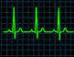

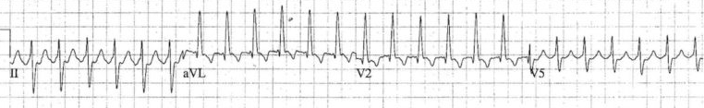
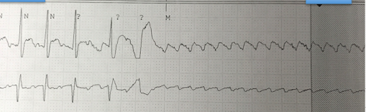
ED Case of the week 5
Learning points
Tachycardia algorithm
Emergency Cardioversion
The Case:
55F with multiple previous episodes of atrial flutter. No other significant PMH.
She had ran out of bisoprolol for the last 3 days, had difficulty getting a new prescription, and that morning developed palpitations and tachycardia
Called YAS who pre alerted due to HR 180 with BP 85/50
On arrival to resus she was sat up talking, clinically very well and repeat BP was 150/83. HR was 180.
Not her actual ECG but similar:
  Narrow complex tachycardia
  ?SVT ?Atrial flutter - it can be very difficult to tell with quick rhythms
  Suspect atrial flutter with 2:1 block if the rate is constantly around 150
So what are our options?
Well let's go through the algorithm, does she have any Adverse features?
  She did with YAS as she was hypotensive, but not currently, so immediate cardioversion is not required
So looking at the algorithm we should be trying vagal manoeuvres and giving adenosine
Interestingly the 2015 algorithm mentions atrial flutter and suggest B-blockers, but the 2021 algorithm doesn’t mention flutter and suggests if no response to adenosine to use B-blockers or verapamil
I suspect that if we tried vagal manoeuvres and adenosine we may have seen this:
Adenosine will block the AV node and make the flutter waves obvious
Great overview of this

Slide 2
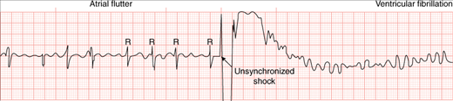
ED Case of the week 5
Our patient:
In most cases like this I would have utilised vagal manoeuvres and given adenosine
But this lady had had multiple episodes of atrial flutter, and never ‘SVT’
So I opted to give her some IV fluid and some IV metoprolol, and treat as flutter
Oral bisoprolol is another option but takes about 2 hours to start to work and with a HR of 180 I wanted to achieve rate control more swiftly
Efficacy and safety of IV beta blockers for rate control has been demonstrated (1, 2, 3). There is some evidence that IV diltiazem may be superior to IV beta blockers (4). I have never used IV diltiazem though, compared to using metoprolol frequently, so I wouldn’t be changing practice on this paper alone. Similarly, a lot of these patients are on beta blockers, and when combined with diltiazem/verapamil there is a risk of AV block and sudden death… so probably best to avoid.
After about 15 minutes the patient said she felt light headed and nauseous
Laid flat, fluid bolus, legs elevated. This gave a transient improvement in symptoms but another 5-10 mins later recurred
BP not recording, radial pulse not palpable, though still conversing and not confused
Now we have adverse features!
Cardioversion
The patient was still conscious so ICU were called to provide sedation and airway support
If the patient is unconscious then proceed to shock!
Make sure it is a synchronised shock - this tells the machine to deliver the shock at the right time to avoid R-T phenomenon and risk of VF. If you don’t know how to sync the defib then ask when you are next working!
If you have never seen a cardioversion here is a live example. Though I do think it is mean they didn’t sedate him! Another example.
How much electricity?
Resus council suggest:
AF - max energy right away (typically 200J biphasic)
Flutter - 70-120J and escalate
VT - 120-150J and escalate
Give up to 3 shocks - if failure then load with amiodarone 300mg and attempt again
Still no success? I would be calling a cardiologist!
Our Case
We started at 150J and failed, escalated to 200J and succeeded!
The patient was subsequently admitted to CCU

