Slide 1
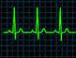

ED Case of the week 6
Learning points
Assessment of back pain in ED
Discussion around cauda equina syndrome
Beware the returners!!
The Case:
32M, obese but no PMH or medications, presented with generalised back pain and reportedly difficulty walking. Assessed and deemed to have a normal gait and impression was of MSK pain secondary to going to the gym. Discharged.
Re-presented 4 days later. Right leg had given way causing him to fall. It was noted he had ‘progressive numbness and pins and needles in both feet’. Power 4 / 5 throughout lower limbs, normal PR exam. No bladder/bowel dysfunction. ??Diabetic neuropathy - Home with GP f/u for OP Investigation
Re-presented another 4 days later. Now had bilateral leg weakness, couldn’t dress himself that morning, no change in bowels and no reported urinary symptoms but on bladder scan had 600mls suggestive of retention.
An MRI was arranged ?cauda equina syndrome
Initial thoughts:
This is his 3rd presentation in 8 days - Re attenders are identified by RCEM Standards as high risk and they suggest consultant / ST4+ discussion
There is clear progression of his symptoms over the attendances - something is not right!!
Diabetic neuropathy seems unlikely - he wasn’t diagnosed as diabetic and it would be unusual to be rapidly progressive or to have initial motor deficit (usually sensory)
Cauda equina syndrome
We hear and think about this a lot in ED with back pain presentations - but what is it and why do we think about it?
This overview covers everything you need to know!
In a nutshell it is compression of the end of the spinal cord that can lead to irreversible nerve damage if not identified and treated rapidly
Aside from the devastating effects on an individual there are also significant medico legal costs - approximately £187 million over a 10 year period - this is up to 2018 so likely even higher now
Ok, so how do we pick it up? Red flags?
NICE guidance, American Association of Neurological Surgeons, BASS
So they all seem to agree on:
  Bilateral sciatica or lower limb neurological weakness
  Bladder / bowel dysfunction (retention or incontinence), and erectile dysfunction
  Saddle anaesthesia / altered anal tone
But interestingly BASS comment ‘The reliability of clinical diagnosis of threatened or actual CES is low and there should be a low threshold for investigation with an emergency MRI scan’

Slide 2
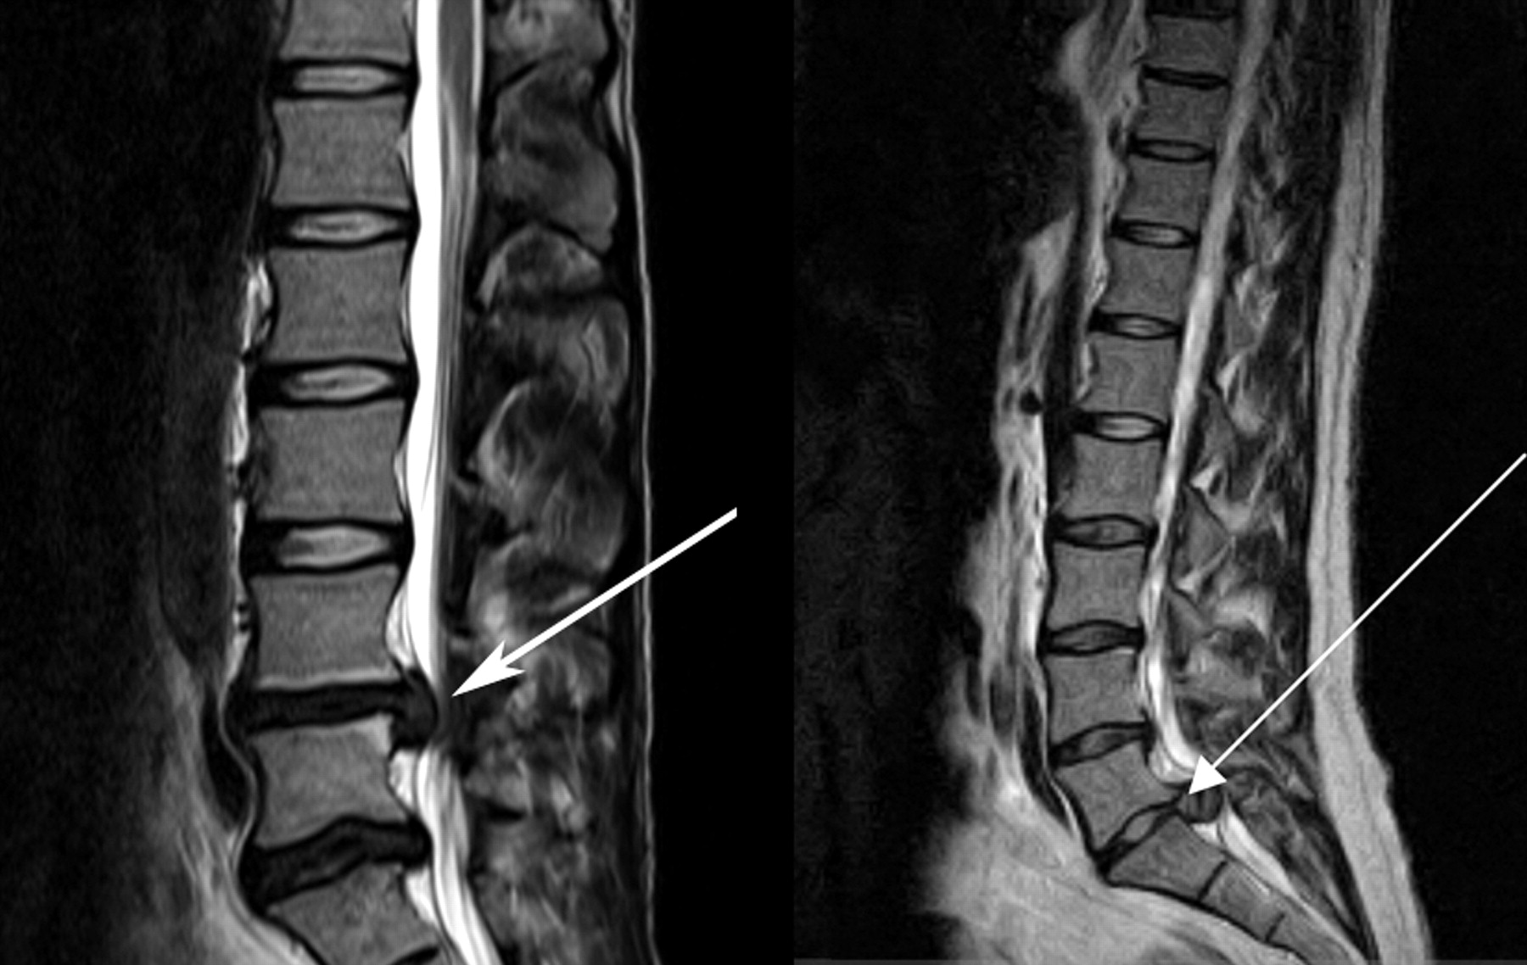
ED Case of the week 6
And the evidence?
Well, in summary, there is no one clinical sign or symptom to suggest CES. It requires a combination of history and clinical examination to decide who needs imaging and who doesn’t. Furthermore, some of these are subjective making assessment more challenging. Ultimately, we need a low threshold for scanning these patients and picking up CES - though accept the majority of scans will be normal (or minor disc pathology)
Evidence Links
Limited value of 1 specific sign
No role for PR in clinical assessment?
Urinary retention the best indicator? (But may be too late once this has developed!)
BMJ article highlighting all the challenges discussed!
RCEM position
Arrows pointing to disc herniation leading to compression of the cauda equina nerve roots
This is all summarised on EMBeds with the CHFT pathway outlined
The Case:
Well…. After all that discussion on cauda equina syndrome… he had a normal lumbar sacral MRI scan. However, he still could not walk so was admitted to MAU.
PTWR - ‘Upgoing plantars and asymmetry to lower limb weakness R >L ?Demyelination ??stroke’
CT head and c spine - Normal too!
Then had MRI head, cervical and thoracic spine and unfortunately showed a large paraspinal mass in the region of T2-T4 extending into the spinal column and causing compression of the spinal cord
He then had a staging CT scan which showed multiple enlarged lymph nodes and hypodense lesions in the spleen and liver
Most likely diagnosis is lymphoma - he has been referred to the Neuro MDT in Leeds and had local haematology input and lymph node biopsies.
Conclusions
Thankfully, not many patients presenting with back pain to the ED are going to have lymphoma but it does highlight the need to be vigilant for that needle in the haystack presentation
Back pain is always difficult to assess, and access to MRI can be challenging, but we need to be aware of the red flags and investigate them when identified. As all the evidence above suggests, clinical examination alone can not confidently exclude pathology
Beware the returner or someone re presenting with progression of symptoms!

