Slide 1
ED Case of the week 7
Learning points
Assessment of trauma patients
Femoral fracture management
The Case:
A 24 year old man was brought to CRH ED in a car by his friends after falling off a 6 foot wall whilst intoxicated
He was unable to walk and had an obviously swollen and deformed right thigh
He was brought round to a cubicle in a wheelchair, given analgesia, and transferred on to a trolley with assistance
Initial thoughts:
He’s in the wrong hospital!
But on a serious note trauma patients will present to CRH and unwell children will present to HRI. A lack of familiarity in assessing these patients in this environment can introduce risk, increase error and lead to suboptimal care
We may not have access to normal pathways and support i.e. a trauma call
A femur fracture in a young male is a high energy injury
As well as looking at that injury we should be asking - what else has he injured?
Cognitive biases
I find cognitive biases fascinating. They are essentially ways our brains trick us and once you are aware of them you will notice them in all aspects of life, not just in medical decision making!
One example is the framing effect which is present everywhere!
Years ago I read this paper in the EMJ and it has stuck with me - it shows how powerful framing can be and how we may be influenced by GP letters / triage information / previous clinic letters / presentation at handovers or in this case… has the patient been pre alerted as a trauma to HRI and been seen in resus by the trauma team? Or driven by friends to CRH and seen in a majors cubicle?
We may end up approaching the cases differently even though they are the same
If interested in cognitive biases this is a 4 part series digging a bit deeper with many more examples
So how do we avoid these pitfalls?
Well the first step is being aware of them, and then we can take actions to mitigate them
Back to the Case:
Knowing this is a high risk mechanism with a high energy injury he is moved to resus and a full trauma assessment is performed

Slide 2
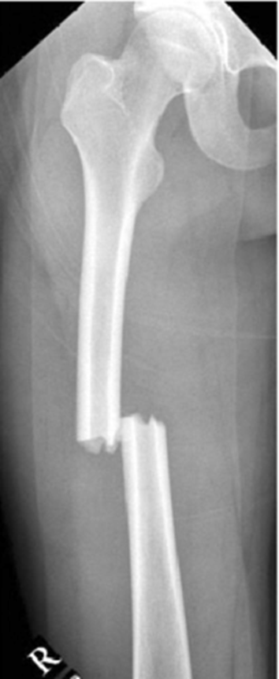
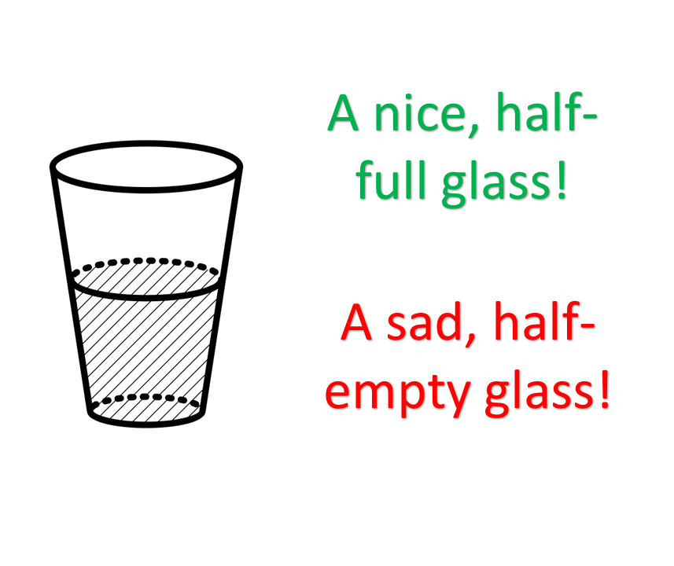
ED Case of the week 7
Trauma assessment
Avoid distraction / fixation to the ‘obvious’ injury
As with any trauma, start with a full A-E assessment - A Primary Survey!
This should identify immediately life threatening problems before moving on to the Secondary Survey
If you haven’t done ATLS these links might serve as a useful introduction to trauma
A great introduction to trauma video
Life in the fast lane - trauma
Back to the Case:
Nil additional found on full primary survey
Deformed swollen right thigh as first identified
Closed injury
Neurovascularly intact limb
Attempted femoral nerve block for some additional analgesia but unable due to patient position
OOH so anaesthetics called to provide sedation support and we pulled the leg to length and placed in a traction splint (you need to be trained to put these on!!)
Went for Trauma CT prior to theatre - nil else found
Management
Femur fractures need to be placed in to traction
You can lose up to 1.5L of blood in a thigh haematoma - which is why they need to be in resus and have a full A-E assessment!
Thomas splint application video - Slightly different to the traction splints we have but demonstrates the concept
Next steps - Transferred to HRI for surgery (Intramedullary nailing) during the day
Conclusions
An interesting case of trauma at CRH
Trauma is all about the mechanism - high energy injuries should lead you to ask what else have they injured?
Having an awareness of cognitive biases can avoid us falling in to those traps - useful for every patient we see!

