Slide 1
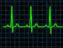

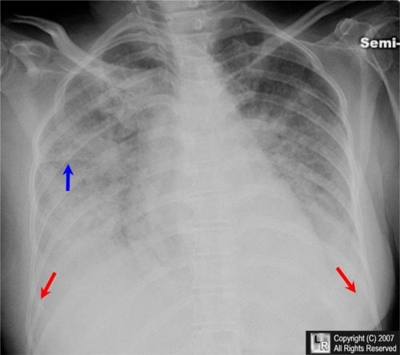
ED Case of the week 10
Learning points
Management of pulmonary oedema
Discuss the role of NIV in these patients
The Case:
A 75F with end stage renal failure on dialysis presented with acute SOB
Previous MI with stents 8 years ago
No chest pain
Had dialysis 2 days ago, completed full session, next due the following day
No fever, no cough, no infective symptoms
No history of VTE
Chest - bibasal crackles, bilateral wheeze, requiring 40% O2
HR 100 SR, BP 200/90, ECG - old LBBB, no new changes
VBG: pH 7.20, pCO2 7.0, pO2 10, bicarb 18, Lactate 1.9, BE -9.0
Initial thoughts:
Pulmonary oedema
??Precipitatinng MI
CXR Changes in Pulmonary oedema
A - Alveolar oedema
B - ‘Batwing’ appearance, Kerley B lines
C - Cardiomegaly
D - Diversion to upper lobes, diffuse interstitial thickening
E - Effusions
Radiology masterclass
Ultrasound appearances
Initial management:
Oxygen - sats 88-92% as retaining
Optimise position - sit up rather than supine / slumped
Nebulisers for wheeze (was probably cardiac wheeze and so did not help)
Furosemide - can still use in dialysis patients, this lady still passed some urine normally
Catheterise to monitor output
Plan to review and repeat gas following initial treatment

Slide 2
ED Case of the week 10
Reviewed again
No improvement
Repeat gas worse
pH 7.10, pCO2 9
Plan to start on GTN and NIV
Pulmonary oedema management
Like with everything, we should target the underlying cause
Medical:
  Nitrates (GTN)
  Diuretics (Furosemide)
Ventilation:
  Appropriate positioning of the pt
  CPAP / BiPAP
CPAP / NIV should be considered early for cardiogenic pulmonary oedema
RCEM Learning - Pulmonary oedema
Non invasive ventilation
As outlined in the RCEM learning module, cardiogenic pulmonary oedema can occur from either:
  Pump failure
  Diastolic failure - present hypertensive as the left ventricle is unable to relax
Our patient was hypertensive with BP 220 systolic prior to starting GTN
  GTN vasodilates and thus reduces pre-load on the heart, and at higher doses also afterload. It improves coronary perfusion and therefore oxygenation.
Non invasive ventilation (CPAP / BiPAP)
  Positive pressure ventilation increases alveolar recruitment, mitigates the right to left shunt and will also reduce pre-load due to higher intrathoracic pressures.
There is a comprehensive NIV guide on EMBeds here.
Video overview of CPAP for pulmonary oedema
Back to our Case:
GTN was started according to protocol:
  50mg in 50ml, start 1ml/hour and titrate according to BP
NIV was started at 12/5 and increased to 20/5 over a 20 minute period
Her breathing improved significantly and her repeat gas had normalised
She was admitted to MAU initially but was transferred to ICU the following day for renal replacement (due dialysis) but was too unstable to transfer for this.
Trop 57 → 14,000. Treated medically for NSTEMI as precipitant of pulmonary oedema
Prognosis
Unfortunately poor for this group of patients
This paper is a great over of cardiogenic pulmonary oedema and quotes a 26% mortality rate for acute presentations, 50% at 1 year and 85% at 6 years
Where appropriate we should take the opportunity to discuss escalation plans with these patients and their families

