Slide 1
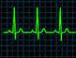

ED Case of the week 8
Learning points
Causes of hyponatraemia
Correction guidelines and targets
The Case:
54M with history of alcohol dependence was found collapsed at home by his Mum
In ED - confused, no recollection of events, vomiting ++
A - maintaining but vomiting ++, B - Sats 82% on 15L O2, RR 40, Coarse crackles bilaterally, C - CRT 5s peripherally, 3s centrally, HR 95, BP 228/105, GCS 14, Abdomen distended but BS present. Looked very unwell.
Blood gas - pH 7.31, Na+ 102, K+ 4.1, Glucose 12, Lactate 8, Bicarb 17
Working diagnosis: Aspiration pneumonia, hyponatraemia
Initial thoughts:
Super sick!
Potential airway at risk with vomiting, high oxygen requirement, hypertensive (Possibly a clue for cerebral oedema), very very low sodium
Hyponatraemia - low sodium
Normal is >135 mmol/L, Mild 130-135, Mod 125-129, Severe <125
So 102 is very severe!
What are the issues? Why do we worry about low sodium?
Confusion, vomiting, seizures
In severe cases such as this - cerebral oedema which is life threatening
Causes? Well, a lot…
Most of the time it will be medications, failures (heart / liver / renal) or dehydration.
This article covers everything hyponatraemia and has an excellent flow chart diagram… but it’s a bit MAU rather than Emergency Medicine.
The emergency bit… when do we need to act in ED?
Guidelines generally suggest hypertonic saline when there are ‘moderate or severe symptoms’
Society for Endocrinology guidance suggests:
  Persistent vomiting
  Cardiac arrest (fair enough! Sounds quite severe)
  Seizures
  Reduced GCS or ‘confusion’

Slide 2
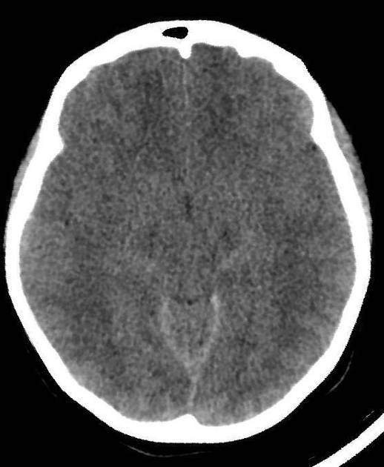
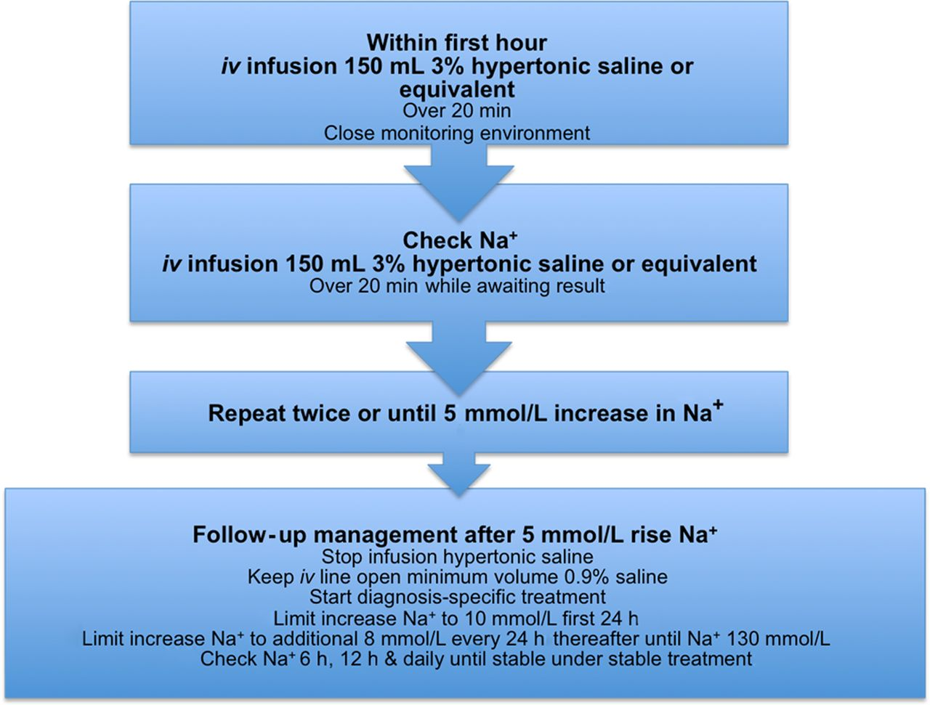
ED Case of the week 8
Back to the Case:
Started on airvo, given Abx, given hypertonic saline, Catheter and NG tube inserted, surgical and critical care reviews planned.
Then had PEA arrest for 10 mins before ROSC
Intubated and taken to ICU after ROSC and stabilisation in ED
CT Head / Thorax / Abdomen / Pelvis:
  Bilateral pneumonia
  Brain parenchymal swelling with impending herniation
Remains an inpatient in ICU currently
Cerebral oedema - note squashed ventricles
Management of severe hyponatraemia
Severe hyponatraemia, as well as addressing underlying causes, is treated with hypertonic saline (either 2.7% or 3%, whichever is stocked)
Guidelines for replacement all suggest very similar regimes, CHFT uses the Society of Endocrinology guideline (below). Found on EMBeds.
It’s a difficult balance between replacing the sodium to stop seizures / cerebral oedema but not too quickly that it causes Central Pontine Myelinolysis which can lead to Locked-in syndrome. Evidence is mostly aimed at stable patients
Targets
An initial rise of 5mmol/L (then stop hypertonic saline)
No more than 10mmol/L in the first 24 hours
Or 8mmol/L / 24 hours after this
Sodium needs to be re checked regularly
And if we over shoot it? Options are:
Hypotonic solutions e.g. Glucose 10ml/Kg
NG Water if absorbed (so not this case)
Desmopressin
Diuretics
(Guided by clinicians with experience in managing these complicated patients)
Key takeaway points
Indications for hypertonic saline
Correction targets
What to do if over corrected
These patients should be managed in a critical care environment

