Slide 1
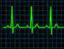

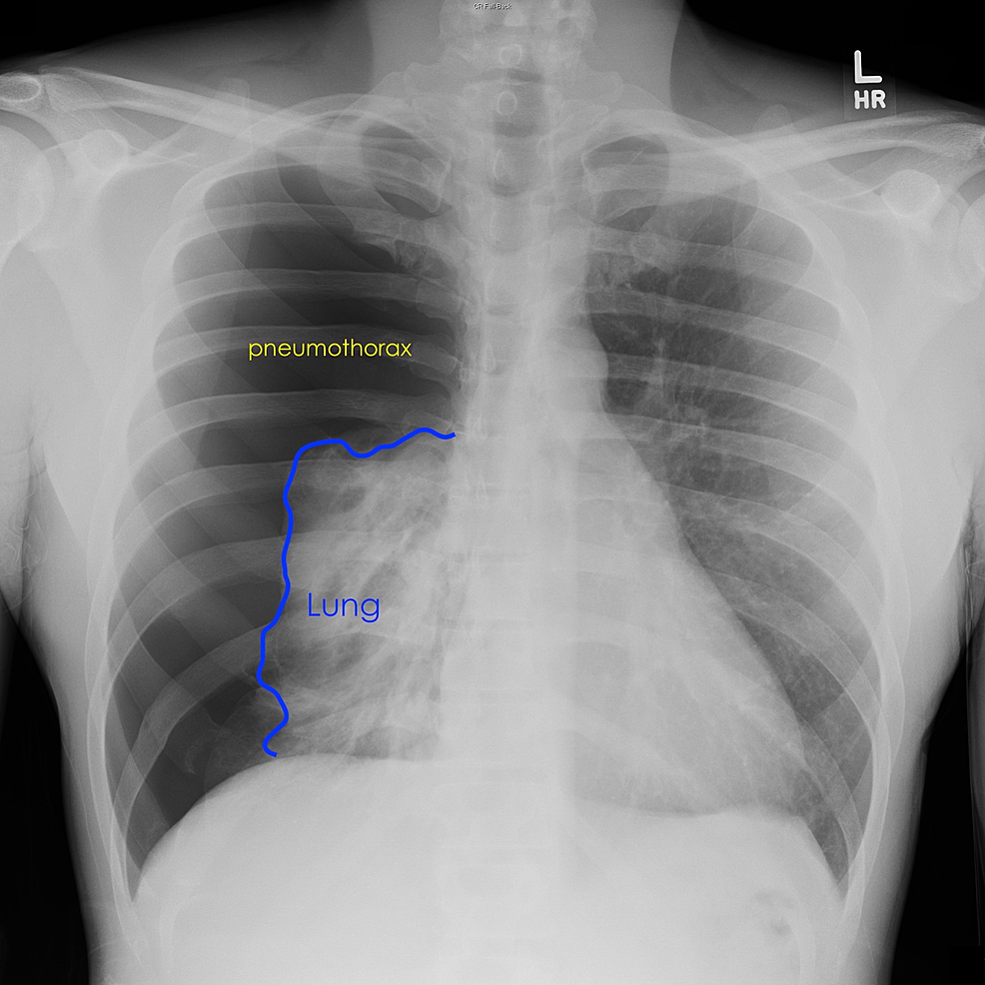
ED Case of the week 9
Learning points
BTS guidance on spontaneous pneumothorax
Decompression / Aspiration / Drain insertion overview
The Case:
A 25M presented to CRH ED with acute onset SOB and chest pain that morning.
Vapes and smokes cannabis regularly. No other PMH.
Sent for CXR which showed a large right sided pneumothorax
No history of trauma. No previous episodes.
Stable observations. Not in respiratory distress. No oxygen requirement.
Initial thoughts:
Well the diagnosis is easy
Let’s move him to resus
Drain or no drain? And how quickly?
Options
Essentially we have 4 options when faced with a pneumothorax:
Needle thoracocentesis decompression (always followed by a drain)
Seldinger chest drain
Needle aspiration
  +/- drain afterwards
Observation only
  High flow oxygen and admit
  Discharge and follow up CXR
So let’s go through these options
Needle thoracocentesis decompression
We do this for tension pneumothorax. Tension can be:
Radiological tension - Pneumothorax, mediastinal shift, tracheal shift, flattened diaphragm
Clinical tension - Haemodynamic instability (tachhycardic, hypotensive, rising O2 req.)
And how?
Paeds - 2nd intercostal space mid clavicular line:
  This study looked at CT chest scans in children and suggested 100% success rated with 22g (blue) in 0-5 year olds, 20g (pink) in 5-10 and 18g (green) in >10.
Adults - 5th intercostal space anterior to the mid axillary line (where we will put our drain)
  5th ICS not 2nd ICS as in larger adults some cannulas can not reach the pleural space, or do and then dislodge / kink / block, leading to high failure rates
  Thoracostomy is another option in emergency situations where decompression has not achieved adequate result. It is the first step in open drain insertion so is also useful in trauma patients who are intubated and ventilated and subsequently tension.
  Thoracostomy is also recommended in ALS in cardiac arrest when tension is suspected (if you needle decompress an arrested patient you should rapidly follow this with a thoracostomy)
  This video discusses the ATLS update from decompressing in the 2nd ICS in adults and demonstrates decompression in 5th ICS

Slide 2
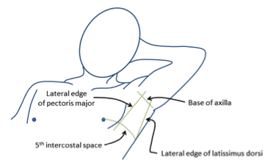
ED Case of the week 9
Seldinger drain insertion
This video demonstrates seldinger technique for drain insertion
This is different to open chest drains utilised in trauma when there is a haemothorax
Seldinger chest drains are smaller and so if there is a haemothorax they are easily clotted by blood
They can be used for both traumatic and spontaneous pneumothoraces
Any patient who has had a tension pneumothorax decompressed via needle or thoracostomy subsequently needs a chest drain insertion
My top tips are to be familiar with all equipment, line it up in order you will need it and take time to properly position your patient - so they are comfortable and you can get to where you need to be
Needle aspiration
This video demonstrates needle aspiration
Again should be done in the ‘triangle of safety’
Use a 3 way tap, a 50ml syringe and be prepared to aspirate large volumes!
Repeat CXR following to assess response
Observation
For minimally symptomatic patients observation only may be an option
See algorithm below - secondary pneumothoraces require high flow O2 and admission (higher risk of deterioration requirement intervention)
Primary pneumothoraces could be managed as an OPD with safety netting advice and planned repeat CXR
Confirming drain position
A CXR can not confirm the position, as it is a 2D representation.
It can show resolution of pneumothorax, and can ensure the most proximal bore in the drain has passed the rib, but a drain that is in the soft tissues of the chest wall may look like it is in the chest.
Confirmation is through improvement in clinical condition and seeing ‘swinging’ on the chest drain - An example here
So how do we decide what to do?
Well, thankfully, there is an algorithm for that, courtesy of the British Thoracic Society and easily accessible on EMBeds
Note ambulatory device is not an option at CHFT
Back to our Case:
Well following our algorithm:
  Symptomatic
  No high risk features
  Safe to intervene
  Patient’s priority was symptom resolution
  We could have aspirated but given the size of the pneumothorax we went straight for a seldinger chest drain. Good resolution of pneumothorax on repeat CXR and admitted to MAU when he was monitored and had a repeat CXR at 24 hours.
Further learning - RCEM Learning

