Slide 1
ED Case of the week 12
Learning points
Assessment of atraumatic limp in children
SUFE diagnosis and management
The Case:
11 year old boy presented to ED with his Dad. Normally well, no PMH / medications or allergies.
2 days previously had developed a twinge in left hip playing football. Completed the game. The next day was slightly worse and was limping, the following day he was unable to walk so was brought to ED via YAS
On assessment he had significant pain reported in his left hip
He was unable to straight leg raise and was in a lot of pain on minimal movements
There was no overlying erythema or skin changes to the leg
Back, abdominal and testicular examinations were normal
He reported tingling in the left leg but sensation was present in all dermatomes
So what are our next steps?
Firstly, analgesia! Apart from being a nice thing to do we need to properly assess him and his degree of pain was limiting our ability to get a good history and examination
He had paracetamol, ibuprofen and then IV morphine and ondansetron
And what are our differentials?
Well, there are many, as the table on the next page demonstrates
But we can skew our differentials based on the age of the child and how well or unwell they are. Also important to differentiate between traumatic and atraumatic presentations.
Importantly we need to exclude all red flags – this child was non weight bearing as opposed to limping which is itself a red flag.
Other important red flags include fever, systemic upset, back pain, night pain, abnormal neurology, limp for more than 4 weeks or suspicion of NAI
Thankfully, this is all summarised nicely on our EMBEDS limping child page

Slide 2
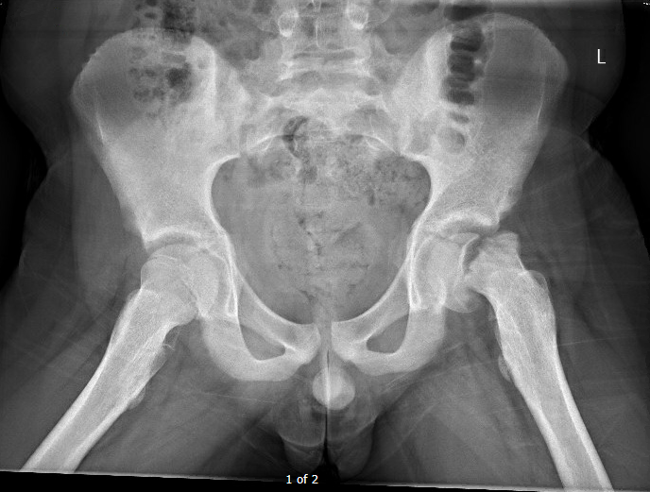
ED Case of the week 12
Back to the Case:
We had cannulated to give him some morphine and so took and sent bloods for inflammatory markers. These were normal.
He was sent for a pelvic and frog leg lateral xray which is shown:
X ray confirmed a left sided SUFE
This case is obvious, but more subtle ones can be missed
Diagnosis can be made by drawing Klein's lines on and looking for Trethowan’s sign. If the lateral femoral epiphysis is not intersected, you have a SUFE!
He was admitted locally under Orthopaedics before subsequently being transferred to the LGI for operative intervention several days later

